Slide 1
Elasticity
4
Notes:
Pre-class music: “Irreplaceable” by Beyoncé (See Tip #124)
You can introduce the lecture on elasticity by playing this song, and asking students, “Is Beyoncé's demand for her boyfriend elastic or inelastic?” It will become clear that he is replaceable, meaning her demand is elastic.

Slide 2
Previously
Demand and supply balance the desires of consumers and producers.
Demand and supply steer the market price toward equilibrium.
We learned the direction of changes in quantity demanded and quantity supplied as a result of a price change.
In this chapter, studying elasticity will help us understand the sensitivity of consumers and producers to changes in price.
Notes:
Lecture tip:
When you go over the third bullet point, remind students that we’ve already discussed a change in demand (a shift in the demand curve), as well as a change in quantity demanded (sliding along the demand curve).
A price change will cause us to slide along the demand curve to a different point on that same curve.
Other factors changing (income, preferences, price of other goods) will cause the demand curve to shift.
We’ve seen the direction of the slide or shift, but now (with elasticity) we will learn more about the size of these changes.

Slide 3
Big Questions
What is the price elasticity of demand, and what are its determinants?
How do changes in income and the prices of other goods affect elasticity?
What is the price elasticity of supply?
How do the price elasticity of demand and supply relate to each other?
Notes:
Lecture notes:
By asking about “determinants,” we’re asking what determines the level of elasticity.

Slide 4
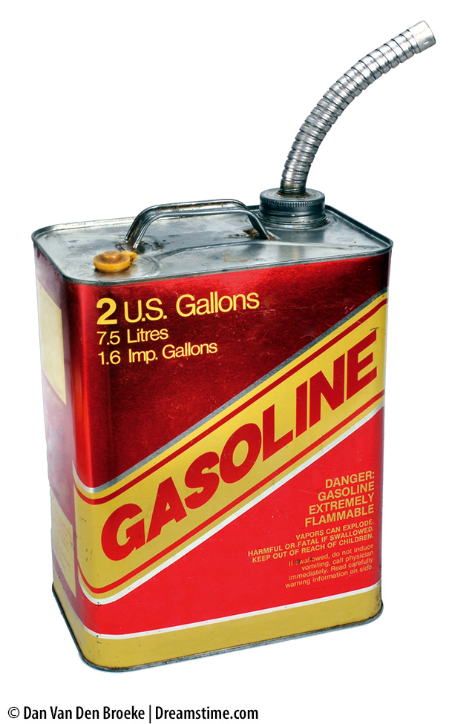
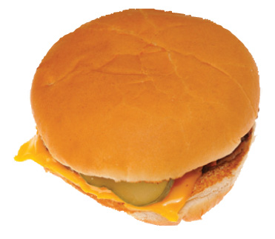
Here’s a question for you…
How do you respond when the price of gasoline rises by 10 percent?
  Does your answer change if we are talking about a 10 percent rise in the price of a Big Mac meal?
Notes:
Lecture tip:
The goal in asking this question is to get students to understand that their response to a 10 percent change in the price of gasoline will be different from that of a 10 percent change in the price of a Big Mac meal.
If it’s easier, start with an initial price of gasoline = $2.00. After the price increase, the price of a gallon is now $2.20.
The price of a Big Mac meal goes from $5.00 to $5.50.
Try to get the students to discuss why they would be less responsive to the change in the price of a gasoline.
Lack of substitutes
More of a necessity
[left: © Dan Van Den Broeke | Dreamstime.com; right: © Michael Neelon(misc) / Alamy]

Slide 5
Price Elasticity of Demand—1
Elasticity
  A measure of the responsiveness of buyers and sellers to changes in price or income
Why is it useful?
  When price or income changes, we can determine how much buyers and sellers change their behavior
Notes:
Lecture tip:
Explain to students that:
Elasticity = responsiveness
Emphasize that elasticity can compare the responsiveness of the relationship between any two variables.
There are several types of elasticity that detail the sensitivity of the relationship between different pairs of variables.
Supply and demand allows us to predict what happens to quantity demanded or quantity supplied in terms of whether it falls or rises; elasticity allows us to be more precise and put a size to that change.
As stated in the “Previously” slide (slide #2):
A price change will cause us to slide along the demand curve to a different point on that same curve.
Other factors changing (income, preferences, price of other goods) will cause the demand curve to shift.
We’ve seen the direction of the slide or shift, but now (with elasticity) we will learn more about the size of these changes.

Slide 6
Price Elasticity of Demand—2
Price elasticity of demand
  A measure of the responsiveness of quantity demanded to a change in price
  This gives us the sensitivity of the relationship between these two variables.
Notes:
Lecture notes:
Recall the law of demand:
Demand curve is downward-sloping.
This gives us the direction of the relationship between these two variables.
Elasticity allows us to be more precise and put a size to that change in QD.
Underscore why this is important to know:
Businesses know if they raise prices, they will sell fewer units.
But how many fewer inputs? That is something they’d like to know.

Slide 7
Price Elasticity of Demand—3
Demand is elastic if
  Quantity demanded changes significantly as the result of a price change
  Elastic = “sensitive” or “responsive”
Demand is inelastic if
  Quantity demanded changes a small amount as the result of a price change
  Inelastic = “insensitive” or “unresponsive”
Notes:
Classroom demonstration: Elasticity as a Rubber Band
This demonstration can be found in the Interactive Instructor’s Guide (see Tip #127).
Use elastic bands to demonstrate responsiveness, but make sure you find some that are difficult to stretch and others that are easy to stretch.
An alternative to using rubber bands is to use a set of “Bounce/No Bounce Balls”
One ball is bouncy, so as you drop it to the floor, it responds by bouncing back (elastic).
The other ball does not respond; when you drop it, it remains on the floor (inelastic).

Slide 8

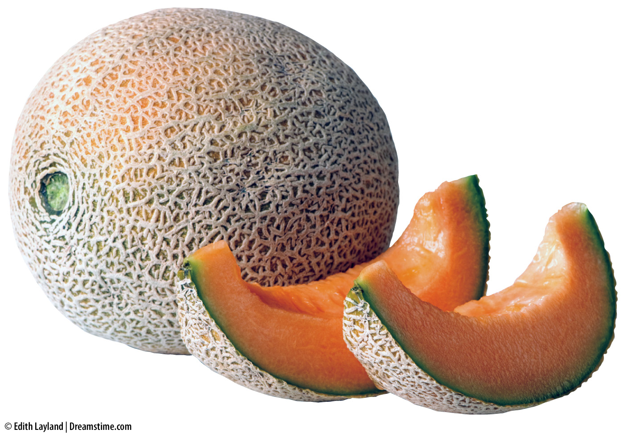
Determinants of the Price Elasticity of Demand—1
Existence of substitutes
Determines the options consumers have when the price changes
  Many substitutes ➔ elastic demand
  Few substitutes ➔ inelastic demand
Notes:
Lecture tip:
Ask students to provide some examples of determinants.
Some possible examples include:
Goods with many substitutes:
Toiletries (toothpaste, deodorant, shampoo, etc.)
Breakfast cereals
Fruits and vegetables
Fast food
Goods with few substitutes:
Clean drinking water
Electricity
Gasoline
Medical goods such as insulin
[fruit: © Edith Layland | Dreamstime.com; lightbulb: © Rick Rhay/iStockphoto.com]

Slide 9
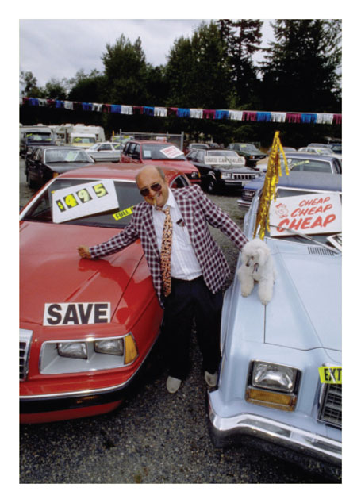
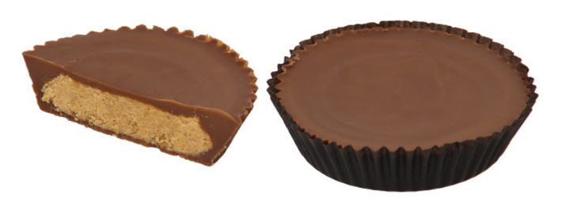
Determinants of the Price Elasticity of Demand—2
Share of the budget spent on the good
Determines how much the price change affects the consumer
  “Big-ticket items” ➔ elastic demand
  Inexpensive items ➔ inelastic demand
Notes:
Lecture tip:
Ask students which of the following events they would react to more:
20 percent sale on a new vehicle you want
20 percent sale on candy bar
The key point to make here is how big the effect will be of a given price change on the person’s life.
[car lot: © Jeffry W. Myers/CORBIS; candy: Evan-Amos/Wikimedia Commons]

Slide 10
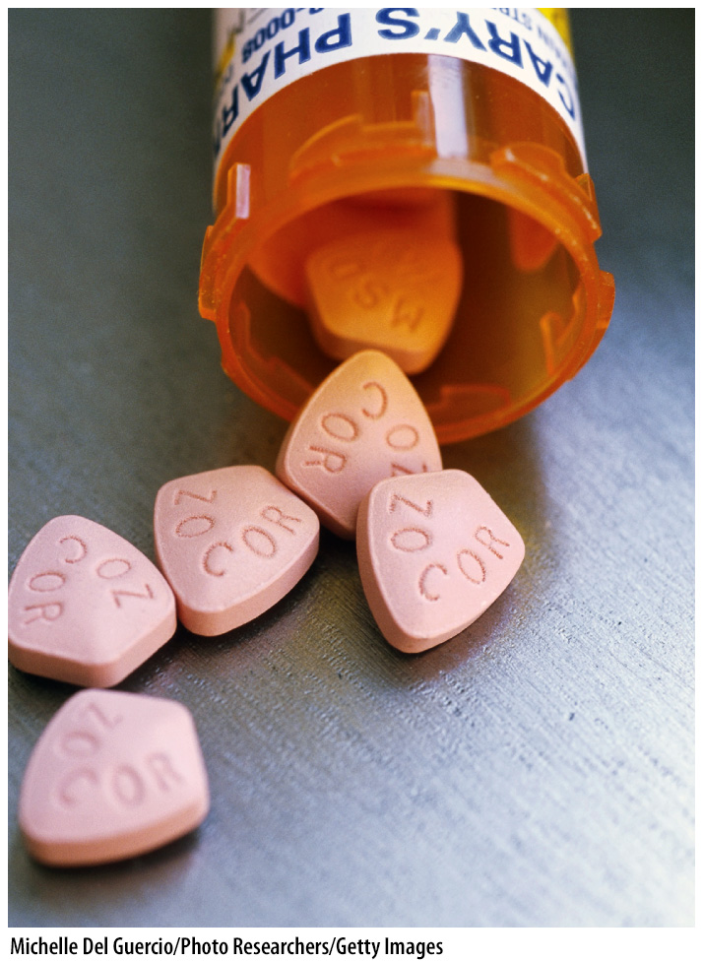

Determinants of the Price Elasticity of Demand—3
Necessities versus luxuries
Affects the options the consumer faces
  Luxuries ➔ elastic demand
  Necessities ➔ inelastic demand
Notes:
Lecture notes:
When the price of a good rises, the consumer will typically want to buy less.
Ask students to suggest some “necessities” in their lives.
Some possible “necessities” include:
Electricity
Internet
Gasoline
Mobile phone service
Clean water
Medication
Toilet paper
Now, ask them to list true “luxuries.”
Some possible “luxuries” include:
Vacations
Dining out
Jewelry
Designer clothes
Imported beers
Follow up by asking them to consider how they would respond to a 10 percent change in the price of each.
For which goods will they alter their purchases by the largest amount?
[pills: Michelle Del Guercio / Photo Researchers / Getty Images/; ring: © Ragoarts | Dreamstime.com]

Slide 11

Determinants of the Price Elasticity of Demand—4
Whether the market is broadly or narrowly defined
Affects the options the consumer faces
  Narrowly defined ➔ elastic demand
  Broadly defined ➔ inelastic demand
Notes:
Lecture notes:
Examples of broadly defined:
Ice cream
Breakfast cereal
Cars
TVs
Examples of narrowly defined:
Breyer’s French vanilla ice cream
Kellogg’s Frosted Flakes
Toyota RAV4
Sanyo 46” Smart TV
Ask students if they can come up with an explanation for why the demand for a specific brand of a good will be more price elastic.
[© Cobalt88 | Dreamstime.com]

Slide 12
Determinants of the Price Elasticity of Demand—5
Time and adjustment process
Affects the ability of consumers to respond to changes in prices
  Long time horizon ➔ elastic demand
  Short time horizon ➔ inelastic demand
Notes:
Lecture tip:
Point out that there are three time periods of interest:
Immediate run
No time to adjust behavior
Perfectly inelastic
Short run
Consumers can partially adjust their behavior
Long run
Consumers can fully adjust to market conditions
Over time, consumers are:
More able to find substitutes
More able to adjust for price changes in other ways
Consuming less of the good
You can provide some examples of this, such as gas consumers shifting to more fuel-efficient cars, or using public transportation
A good example of when there is little time to make a decision is a medical emergency.
Suggested video clip: The Simpsons, “I Love Lisa” (See Tip #137)
Homer forgets until the last minute to buy Marge a Valentine’s Day gift, so he ends up paying $100 for a box of chocolates.
Classroom activity: Think-Pair-Share: Examples of Demand Elasticity (See Tip #152).
This is a useful activity for reviewing all of the factors that affect the price elasticity of demand.

Slide 13
Practice What You Know—1
In terms of price elasticity of demand, which of the following goods do you think is the least elastic (most inelastic)?
  new house
  electricity to power your home
  a specific brand of breakfast cereal
  new vehicle
Notes:
Clicker question:
Correct answer: B, electricity to power your home
Houses and vehicles are elastic since they make up a big portion of your budget.
A specific type of cereal is elastic since it has a lot of substitutes.
Electricity has no viable substitutes.

Slide 14
The Price Elasticity of Demand Formula
∆ = change
Notes:
Lecture tip:
It is a good idea to go through several numerical examples using this equation. Make sure to calculate both elastic and inelastic numbers.

Slide 15
Example: Calculating E_{D}—1
University parking pass prices increase by 50 percent.
As a result, 25 percent fewer people purchase a parking pass.
PLUG IN NUMBERS
Notes:
Lecture tip:
Click to show the plugged-in numbers.
Lecture notes:
We are plugging in the numbers to get our elasticity value. In this case, the division is pretty simple.

Slide 16
Example: Calculating E_{D}—2
What does the numerical result mean?
  If the price of parking rises by 1 percent, the quantity demanded will fall by only 0.5 percent.
    The demand for parking is not very price elastic.
Why is it negative?
  Inverse relationship between price and quantity demanded
Notes:
Lecture notes:
Note that elasticity is unitless.
The percentage changes cancel out.
We are left with just a number. What does the number mean?
It’s a measure of sensitivity.
A big negative number means more sensitivity. A small negative number means less sensitivity.
Classroom activity:
Repeat the problem with parking by asking students to use the price elasticity of demand to predict how buyers’ behavior will change:
E_{D} = -0.5. The university is planning to reduce parking fees by 20 percent. What will happen to Q_{D}? (It will increase by 10 percent.)
E_{D} = -0.5. The university would like to increase the Q_{D} of parking passes by 20 percent. What will it have to do with parking fees? (It will reduce them by 40 percent.)

Slide 17
Practice What You Know—2
Suppose that the price of candy bars increases by 100 percent. As a result of this, you decide to purchase 50 percent less candy bars. How would you describe your demand for candy bars?
  Demand is elastic.
  Demand is unit elastic.
  Demand is inelastic.
  Demand is perfectly inelastic.
Notes:
Clicker question:
Correct answer: C, Demand is inelastic
Price is “less important” than quantity. Mathematically, the numerator (%Q_{D} change) is less than the denominator (%Price change), so the magnitude is smaller than one. This is inelastic (relatively insensitive).

Slide 18

Midpoint Method—1
One issue with using the percent change formula
  Price decreases from $100 to $80
    A 20 percent change
  Price increases from $80 to $100
    A 25 percent change
We would get different answers in calculating elasticity
Notes:
Lecture notes:
Typically, percentage change is calculated as [New value – Old value]/Old value.
The value changes as you switch the values around.
Elasticity should be the same going in either direction, so we need to find a way to fix this.
This is why we use the midpoint method.
[© apcuk/iStockphoto.com]

Slide 19
Midpoint Method—2
The midpoint method is way to calculate elasticity that corrects this problem.
Notes:
Lecture tip:
It’s best to explain each parenthetical term one at a time.
First click:
ΔQ_{D} = Q₂ – Q₁
Second click:
Average of Q_{D} = (sum of the two Q_{D}s divided by 2) = (Q₁ + Q₂)/2
Third click:
ΔP = P₂ – P₁
Fourth click:
Average of P = (sum of the two Ps divided by 2) = (P₁ + P₂)/2

Slide 20
Midpoint Method—3
Example:
  “Old” price = P₁ = $6; Q₁ = 15
  “New” price = P₂ = $4; Q₂ = 25
Plug in numbers
Notes:
Lecture tip:
First point out that when the price falls from $6 to $4, quantity demanded rises (as we expect).
All we are going to do is plug in these numbers into this formula.
Stop after the numbers are plugged into the equation to ensure students see where they have come from.
It is helpful to provide students with more examples. Ask them to solve problems in pairs and compare their answers.

Slide 21
Graphing Price Elasticity—1
If demand is relatively elastic
  We are relatively sensitive to price changes
  The demand curve is relatively flatter
If demand is relatively inelastic
  We are relatively insensitive to price changes
  The demand curve is relatively steeper

Slide 22
Graphing Price Elasticity—2
Numerator is zero!
Notes:
Image: Animated Graph Figure 4.1A
Lecture notes:
First click:
Original price = P₀
Second click:
New price is P₁
Third click:
There is no change in quantity demanded
If a good is perfectly inelastic, it means you are willing to pay anything to receive the good or service.
Some examples of perfectly inelastic goods include:
Insulin (if you are diabetic)
Health care for your beloved pet

Slide 23
Graphing Price Elasticity—3
Notes:
Image: Animated Graph Figure 4.1B
Lecture notes:
Some examples of relatively inelastic goods include:
Gasoline
When the price of gas goes up, people do not change their driving habits very much.
Cigarettes
Higher prices (usually in the form of sin taxes) are accompanied by only small decreases in smoking. This actually results in large revenues from cigarette taxes.
Emphasize the word “relatively” when introducing relatively inelastic goods. Technically, we cannot call this an inelastic demand curve, since there is actually an elastic and inelastic section on the line. It is, however, “relatively” more inelastic than a curve that is flatter.

Slide 24

Graphing Price Elasticity—4
Notes:
Image: Animated Graph Figure 4.1C
Lecture notes:
Some examples of relatively elastic goods include:
Fruits, vegetables, and breakfast cereals
There are many substitutes for these goods.
The substitutes may not be identical, but they are close enough so we will be more sensitive to price changes in these goods.
Emphasize the word “relatively” when introducing relatively elastic goods. Technically, we cannot call this an elastic demand curve, since there is actually an elastic and inelastic section on the line. It is, however, “relatively” more elastic than a curve that is steeper.

Slide 25
Graphing Price Elasticity—5
Denominator is zero!
Notes:
Image: Animated Graph Figure 4.1D
Lecture notes:
Some examples of perfectly elastic demands include:
$10 bill
No one will give you more than $10 for it.
Grade A large eggs from one farmer (not the market)
Identical across farmers
If all farmers are selling for $1.50 per dozen and Farmer John decides he wants to price at $2 per dozen, he will sell no eggs
Too many other options for buyers for the same product
If there are perfect substitutes for the good, demand will be perfectly elastic
Example 2 gives students a start to understanding the firm’s demand curve when we discuss perfect competition.
Real-world example: Mnemonic Device for Elastic and Inelastic Demand Curves (See Tip #154)
At the end of this section, teach students the trick that turns a capital I into the perfectly inelastic demand curve and how a capital E has a middle that resembles a perfectly elastic demand curve.

Slide 26
Time, Elasticity, and Demand Curve
Notes:
Image: Animated Figure 4.2
Lecture notes:
First click:
Immediate run
No change in quantity demanded; Q_{D} remains at Q₁
No time to adjust at all
Second click:
Short run
Time for a small adjustment
Q_{D} falls to Q₂, a slight decrease
Third click:
Long run
Time for full adjustment
Demand is more elastic, and Q_{D} falls to Q₃

Slide 27
Slope and Elasticity
Elasticity and the slope of the demand curve are related but are NOT the same.
In fact, with a linear demand curve:
  The slope will be the same at all points.
  Elasticity will be different at all points.
  Elasticity decreases (gets more inelastic) as we move down and right along a linear demand curve.
Notes:
Lecture notes:
The downward-sloping demand gives the elasticity coefficient the negative sign. However, the slope is not the same as the elasticity.
Demand is elastic at high prices and inelastic at low prices.
Ask students to consider a 1 percent change in a large price versus a 1 percent change in a low price.

Slide 28
Difference between Slope and Elasticity
Notes:
Image: Animated Figure 4.3
Lecture Tip:
Work through each of these points with your students.
Price falls from $5 to $4, and Q rises from 0 to 1.
%ΔP = -22 %ΔQ = 200
E_{D} = 200/-22 = -9.1
Click to show answer.
Price falls from $4 to $3, and Q rises from 1 to 2.
%ΔP = -29 %ΔQ = 67
E_{D} = 67/-29 = -2.3
Click to show answer.
Price falls from $3 to $2, and Q rises from 2 to 3.
%ΔP = -40 %ΔQ = 40
E_{D} = 40/-40 = -1
Click to show answer.
Price falls from $2 to $1, and Q rises from 3 to 4.
%ΔP = -67 %ΔQ = 29
E_{D} = 29/-67 = -0.4
Click to show answer.
Price falls from $1 to $0, and Q rises from 4 to 5.
%ΔP = -200 %ΔQ = 22
E_{D} = 22/-200 = -0.1
Click to show answer.

Slide 29
Demand Elasticity and Total Revenues
Total revenue
  The amount that consumers pay and sellers receive for goods and services
  Calculated as:
    Price of the good × Quantity Sold
Elasticity is related to total revenue
  Firms want to know how changing
  their prices affects their total revenue
Notes:
Lecture tip:
After you define total revenue, return to the previous slide and show students how to find total revenue on the diagram.

Slide 30
Example
P | Q_{D} | TR = (P) × (Q_{D}) | %∆P | %∆Q_{D} | E_{D} | Interpretation
$5 | 0 | $0 | -22% | 200% | -9.1 | Highly elastic
$4 | 1 | $4 | -29% | 67% | -2.3 | Relatively elastic
$3 | 2 | $6 | -40% | 40% | -1.0 | Unitary
$2 | 3 | $6 | -67% | 29% | -0.4 | Relatively inelastic
$1 | 4 | $4 | -200% | 22% | -0.1 | Highly inelastic
$0 | 5 | $0
Notes:
Lecture tip:
The example above uses information from the demand curve drawn in Figure 4.3 (on Slide 29).
Click through this slide to show/hide the different rectangles.
Point out the calculation of total revenue and then what is happening to revenue when demand is elastic and inelastic.
The red shape at the end emphasizes that revenue is maximized at the unit elastic portion of the demand line.
The key takeaways from this slide should be:
When demand is elastic, a decrease in price raises total revenue.
When demand is inelastic, a decrease in price lowers total revenue.
When demand is unit elastic, a decrease in price has no effect on total revenue.

Slide 31
Price Elasticity of Demand and Total Revenue
Graphically, we can also show trade-offs when a firm changes the price of its good.
  Increase price
    Good news: Receive higher price per unit
    Bad news: Sell fewer units
  Reduce price
    Good news: Sell more units
    Bad news: Receive lower price per unit
Notes:
Lecture notes:
This is also the intuition of the trade-off (“I could sell more, but I must lower my price to do that”).
There’s good news with changing price, but there is bad news too.
The end effect on total revenue is determined by which effect is larger.
Big assumption: Assume all units are sold at the same price. We are not price-discriminating here; price discrimination is talked about in a later chapter.

Slide 32
Total Revenue Trade-Offs—1
Notes:
Image: Animated Figure 4.4A
Lecture notes:
Throughout the clicks:
Price is falling from $4 to $3
Q is rising from 1 to 2
Bad news: We have to sell units for $1 less (the first unit we were selling for $4), so we lose $1
Good news: We now sell one more unit at a price of $3, so we gain $3
Good news > bad news
Revenue rises
In the elastic region of the demand curve, lowering price will increase total revenue. The gains from increased purchases (the blue-shaded area) are greater than the losses (the pink-shaded area) from a lower purchase price.
At a price of $4, one unit is sold and total revenue is $4. When the price is lowered to $3, two units are sold, so the total revenue is now $3×2 = $6. So, by lowering the price from $4 to $3, the business has generated $2 more in revenue. But to generate this extra revenue, the business gives up $1 for each unit it sells because $1 in sales revenue is lost from lowering the price from $4 to $3. This is represented by the pink-shaded area under the demand curve in the figure.

Slide 33
Total Revenue Trade-Offs—2
Notes:
Image: Animated Figure 4.4B
Lecture notes:
Throughout the clicks:
Price is falling from $3 to $2
Q is rising from 2 to 3
Bad news: We have to sell two units for $1 less (the first two units we were selling for $3), so we lose $2
Good news: We now sell one more unit at a price of $2, so we gain $2
Good news = bad news
Revenue remains the same

Slide 34
Total Revenue Trade-Offs—3
Notes:
Image: Animated Figure 4.4C
Lecture notes:
Throughout the clicks:
Price is falling from $2 to $1
Q is rising from 3 to 4
Bad news: We have to sell three units for $1 less (the first three units we were selling for $2), so we lose $3
Good news: We now sell one more unit at a price of $1, so we gain $1
Good news < bad news
Revenue falls

Slide 35
Practice What You Know—3
Suppose a firm is selling a product at a price on the inelastic portion of the demand line. This firm could increase revenue by doing what?
  lowering the price, selling more units
  lowering the price, selling less units
  increasing the price, selling more units
  increasing the price, selling less units
Notes:
Clicker question:
Correct answer: D, increasing the price, selling less units
Why is (C) not correct? The demand curve is downward-sloping. We can’t increase the price and sell more, or we would be picking a point that isn’t even on the demand line.
By increasing the price and selling less units, we are moving toward the unit elastic point in which revenue is maximized.
Remind students that revenues are not profits. We don’t have any information regarding costs here.

Slide 36

Income Elasticity—1
Changes in income
  Shift the demand curve
  But, by how much?
Income elasticity of demand
  Measures how a change in income affects spending
Notes:
Lecture notes:
Price is not the only variable that determines how much of a good we buy. Other factors such as income determine our consumption as well.
A different type of elasticity (with different variables now) is income elasticity. Now, we ask how sensitive our consumption is with regard to a change in income.
Lecture tip:
Be careful to note the difference again between a movement and a shift in demand.
[© Andres Rodriguez | Dreamstime.com]

Slide 37
Income Elasticity—2
E_{I} can be positive or negative
  Normal good: E_{I} > 0
    Necessities: 1 > E_{I} > 0
    Luxuries: E_{I} > 1
  Inferior good: E_{I} < 0
Notes:
Lecture tip:
Point out to students that the equation is very similar to the one we have seen before.
The numerator is the same.
The denominator is now a change in income instead of a change in price.
Note that we are holding price (and everything besides Q_{D} and income) constant here. How much more (or less) do you buy when income changes, all other things equal?
Remind students that they learned the definitions for normal and inferior goods in Chapter 3.
Ask students to define these terms for as review.
The midpoint method can be used for these calculations as well.

Slide 38
Practice What You Know—4
State whether you think the following goods are inferior, necessity, or luxury goods:
Steak
Toothpaste
Fast food
Pedicures
New vehicles
Used vehicles
Laptop computers
Lawn-care service
Milk
Gasoline
Cigarettes
Lottery tickets

Slide 39
Practice What You Know—5
Suppose that Doug receives a pay increase at work, and his income increases by 20 percent. As a result, Doug decides to buy 12 percent less ground beef. For Doug, ground beef is a(n) ________.
  luxury good
  necessity good
  normal good
  inferior good
Notes:
Clicker Question
Correct answer: D, inferior good
More income leads to less consumption. This is a characteristic of an inferior good.

Slide 40
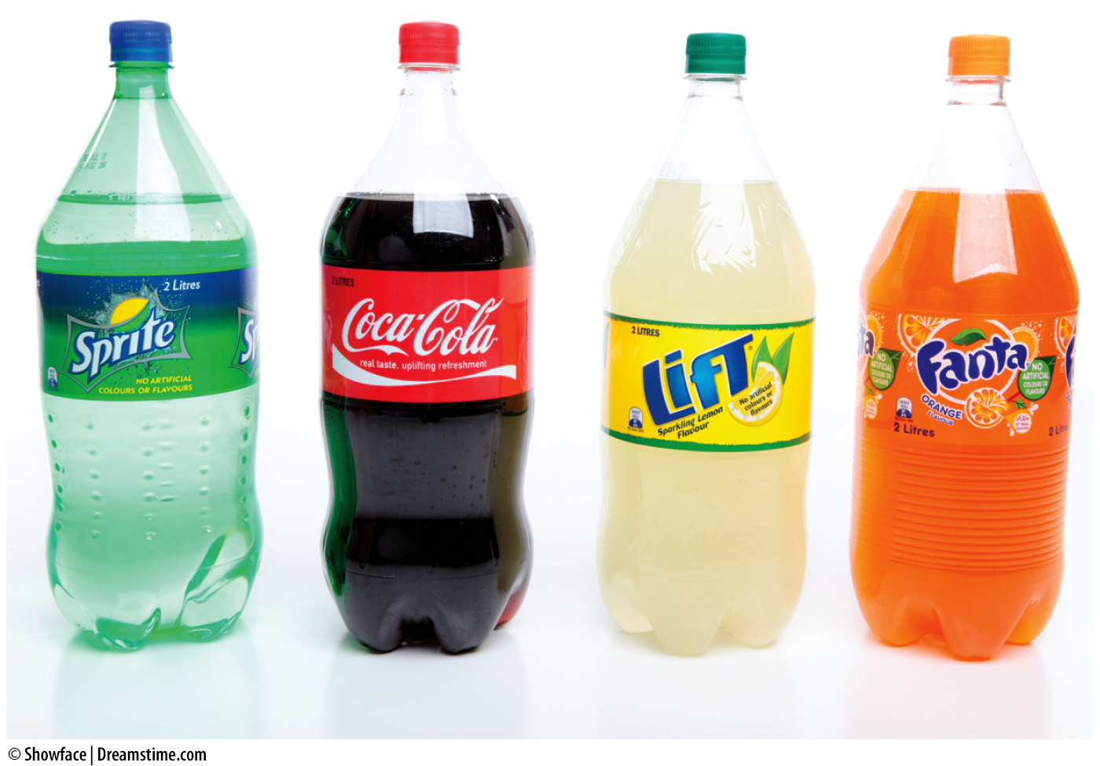
Cross-Price Elasticity—1
Changes in the prices of complements and substitutes also affect demand.
Cross-price elasticity of demand
  Measures the responsiveness of the quantity demanded of one good to a change in the price of a related good
Notes:
Lecture notes:
Review what was discussed about complements and substitutes in Chapter 3.
When the price of apples falls, the demand for oranges rises. But by how much?
When the price of tennis rackets rises, the demand for tennis balls falls. But by how much?
[© Showface | Dreamstime.com]

Slide 41
Cross-Price Elasticity—2
E_{C} can be positive or negative
  Substitute goods: E_{C} > 0
  Complementary goods: E_{C} < 0
Notes:
Lecture notes:
Notice that the equation above is very similar to the ones we have seen before.
The numerator is the same.
The denominator is now a change in price of a related good.
Note that we are holding price (and everything besides Q_{D} of good A and price of good B) constant here.
Lecture tip:
Remind students that they learned the definitions for complements and substitutes in Chapter 3.
Ask them to define these terms for you as review.
The midpoint method can be used for these calculations as well.

Slide 42
Practice What You Know—6
Economists have studied that when the price of chicken increases, people purchase less rice. With these two goods, which of the following is true?
  E_{C} < 0, chicken and rice are complements
  E_{C} > 0, chicken and rice are complements
  E_{C} < 0, chicken and rice are substitutes
  E_{C} > 0, chicken and rice are substitutes
Notes:
Clicker question:
Correct answer: A, E_{C} < 0, chicken and rice are complements.
E_{C} < 0 (the key words are “increase” in chicken price; purchase “less” rice)

Slide 43
Price Elasticity of Supply
Producers also respond to changes in price.
Price elasticity of supply
  Measures the responsiveness of the quantity supplied to a change in price
Notes:
Lecture notes:
The only difference here is that we are examining how a firm reacts to a change in price, rather than a consumer.

Slide 44
Determinants of the Price Elasticity of Supply—1
Flexibility of producers
  More production flexibility implies firms are more able to respond to changes in price
  A firm will have more production flexibility if it is able to:
    Have spare capacity
    Maintain inventory
    Relocate easily
Notes:
Lecture notes:
Example of elastic supply:
De Beers diamonds has raw, uncut diamonds in inventory that aren’t put on the market yet.
If the price goes up, it is very easy to put these diamonds for sale.
Hotdog vendors can adapt easily to changes in demand
It is easy to relocate to a higher-demand area (where price is higher).
Examples of inelastic supply:
Sporting events
It is not easy to add more stadiums (or even more seats within an existing stadium) if the price goes up.
Fresh fish at the dock
What is available today is what was caught today; this cannot change easily.

Slide 45
The Determinants of the Price Elasticity of Supply—2
Time and adjustment process
  Immediate run
    Suppliers are stuck with what they have on hand; no adjustment
  Short run, long run
    Over time, the firm is able to adjust to market conditions.
    Supply becomes more elastic.
Notes:
Lecture notes:
Analogous to demand: supply becomes more responsive in the long run when there is more time to adjust to changing market conditions.

Slide 46
Supply Elasticity over Time
Notes:
Image: Animated Figure 4.5
Lecture notes:
First two clicks:
Immediate run
No change in quantity supplied; Q_{S} remains at Q₁
No time to adjust at all
Next two clicks:
Short run
Time for a small adjustment
Q_{S} rises to Q₂, a slight increase
Next two clicks:
Long run
Time for full adjustment
Supply is more elastic, and Q_{S} rises to Q₃

Slide 47
Calculating the Price Elasticity of Supply
This ratio will be positive
  Law of Supply
    Positive relationship between price and quantity supplied
Notes:
Lecture notes:
Notice that the equation is very similar to the one we have seen before.
The numerator is the same except we are talking about quantity supplied, not quantity demanded.
The denominator is still the change in price.
Lecture tip:
This is the last of the elasticity formulas you will cover. Make sure students recognize that they all have a familiar look to them.
They are measuring the sensitivity of one variable (either Q_{D} or Q_{S}) to a change in another (own price, income, price of a related good).
The midpoint method can be used for these calculations as well.

Slide 48
Combining Supply and Demand
We’ve previously drawn shifts in demand and supply, and studied the changes in equilibrium price and quantity.
How will the magnitude of the price and quantity changes be affected if we alter the demand or supply elasticity?

Slide 49
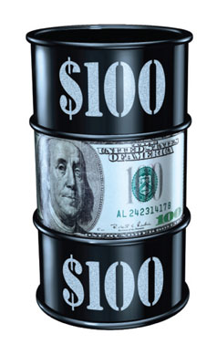
Increase in Demand for Oil from China
Notes:
Image: Animated Figure 4.6
Lecture notes:
Start in equilibrium with SR supply and D₁ initial price = $60 per barrel and Q₁ barrels are sold.
First click:
Economic development in China increases the demand for oil.
Ask students to predict the outcome—what will happen to equilibrium price and quantity?
The demand curve shifts to D₂.
Second click:
The new equilibrium price is $90, and the equilibrium quantity rises to Q₂.
Third click:
Over time, the supply of oil is more elastic and can adjust to the higher price of oil by producing more.
The supply curve gets flatter and becomes S_{LR}.
Fourth click:
The long-run equilibrium price is $80 per barrel, and the long-run equilibrium quantity is Q₃.
[PSL Images / Alamy]

Slide 50
How Do We Decrease Illegal Drug Use?—1
Do you think the demand for illegal drugs is relatively elastic or inelastic. Why?
  Relatively inelastic
  No substitutes
  May make up a small percent of income
  Addiction may increase willingness to pay
  Purchases may be made in the immediate or short run
Notes:
Real-world example: How Do We Decrease Illegal Drug Use? (See Tip #161)

Slide 51
How Do We Decrease Illegal Drug Use?—2
Suppose that we wanted to enact a policy with the following goals:
  Greatly decrease drug consumption
  Make drug-dealing a less attractive business
Should we try to:
  Decrease the supply of drugs?
  Decrease the demand for drugs?
Notes:
Real-world example: How Do We Decrease Illegal Drug Use? (See Tip #161)
Lecture notes:
To decrease the supply of drugs:
Tougher laws for drug dealers
More police enforcement
To decrease the demand for drugs:
Drug education programs
Offer (legal) substitute activities to decrease drug demand

Slide 52
How Do We Decrease Illegal Drug Use?—3
Let’s start with a decrease in supply:
Only a small decrease in drug transactions
Increase in drug prices
Increase in drug revenues
This may actually make drug-dealing more lucrative (and dangerous)
P
S₂
S₁
P₂
E₂
P₁
E₁
D
Q₂
Q₁
Q
Notes:
Real-world example: How Do We Decrease Illegal Drug Use? (See Tip #161)
Lecture notes:
Start at equilibrium:
Price = P₁
Quantity = Q₁
Revenue is shown by blue box
Going through the clicks:
Decrease in supply
Price rises to P₂
Quantity falls to Q₂
Total revenue is now purple plus red box (higher)

Slide 53
How Do We Decrease Illegal Drug Use?—4
Let’s try a decrease in demand:
Larger decrease in drug transactions
Decrease in drug prices
Decrease in drug revenues
Drug dealing is now less attractive
P
S
P₁
E₁
P₂
E₂
D₂
D₁
Q₂
Q₁
Q
Notes:
Real-world example: How Do We Decrease Illegal Drug Use? (See Tip #161)
Lecture notes:
Start at equilibrium:
Price = P₁
Quantity = Q₁
Revenue is shown by blue box
Going through the clicks:
Decrease in supply
Price falls to P₂
Quantity falls to Q₂
Total revenue is now purple box

Slide 54
How Do We Decrease Illegal Drug Use?—5
If we want to accomplish our two goals . . .
  Policy of decreasing drug demand will be better than trying to decrease drug supply
  Better to use resources on education and offering legal substitutes rather than increasing penalties and police enforcement
Notes:
Real-world example: How Do We Decrease Illegal Drug Use? (See Tip #161)

Slide 55
Conclusion
Elasticity is a measure of sensitivity (responsiveness) between two variables.
The ability to determine whether demand and supply are elastic or inelastic allows economists to calculate the effects of personal, business, and policy decisions.
Understanding elasticity helps our economic model say much more about the world.

